Slide 1


Progress Report: 3
Team Charlie
Aakansha Bhatt, Anshu Paudyal, Ingmar Diaz, Michael Foster, Raunaq Chopra, Yang Ye
21st January 2021

Slide 2
Teamwork via zoom
We explain the work done together as a team:
worked together to complete the flowchart for the system. (90% complete)
Ongoing testing of the speedometer firmware
Zoom discussion on the power analysis and its hardware implementation.
Discussion on the types of the switches to be implemented for the solar fuel gauge.

Slide 3
Aakansha Bhatt
Hardware: NA
Mechanical Design: NA
Firmware: I will be helping Michael and Ingmar with the OLED display this week.
Software: I implemented the speedometer code and temperature detection using PSOC 6. Testing in progress. Ingmar is testing it for me since I do not have my ADALM 2000. I am also going to start working on the OLED display this coming week.

Slide 4
Anshu Paudyal
This week
Hardware: Rover has been successfully built and unbuilt again to check the motors; the capacitor charging using the solar panel and discharging using the rover was achieved 50%, the power analysis was completed, Researched on H-bridges
Mechanical Design: flowchart 90% completed (worked with Ingmar)
Firmware: Ongoing checking of the speedometer firmware
Software: N/A
More this week and Next Week
Make the rover run for more than 8 sec using the charged capacitor
Complete the implementation of solar fuel gauge using the H-bridges circuit

Slide 5
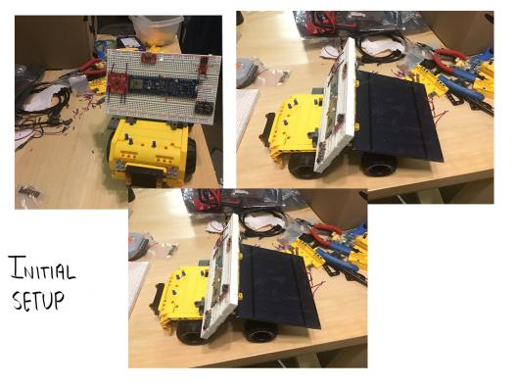
Anshu Paudyal

Slide 6
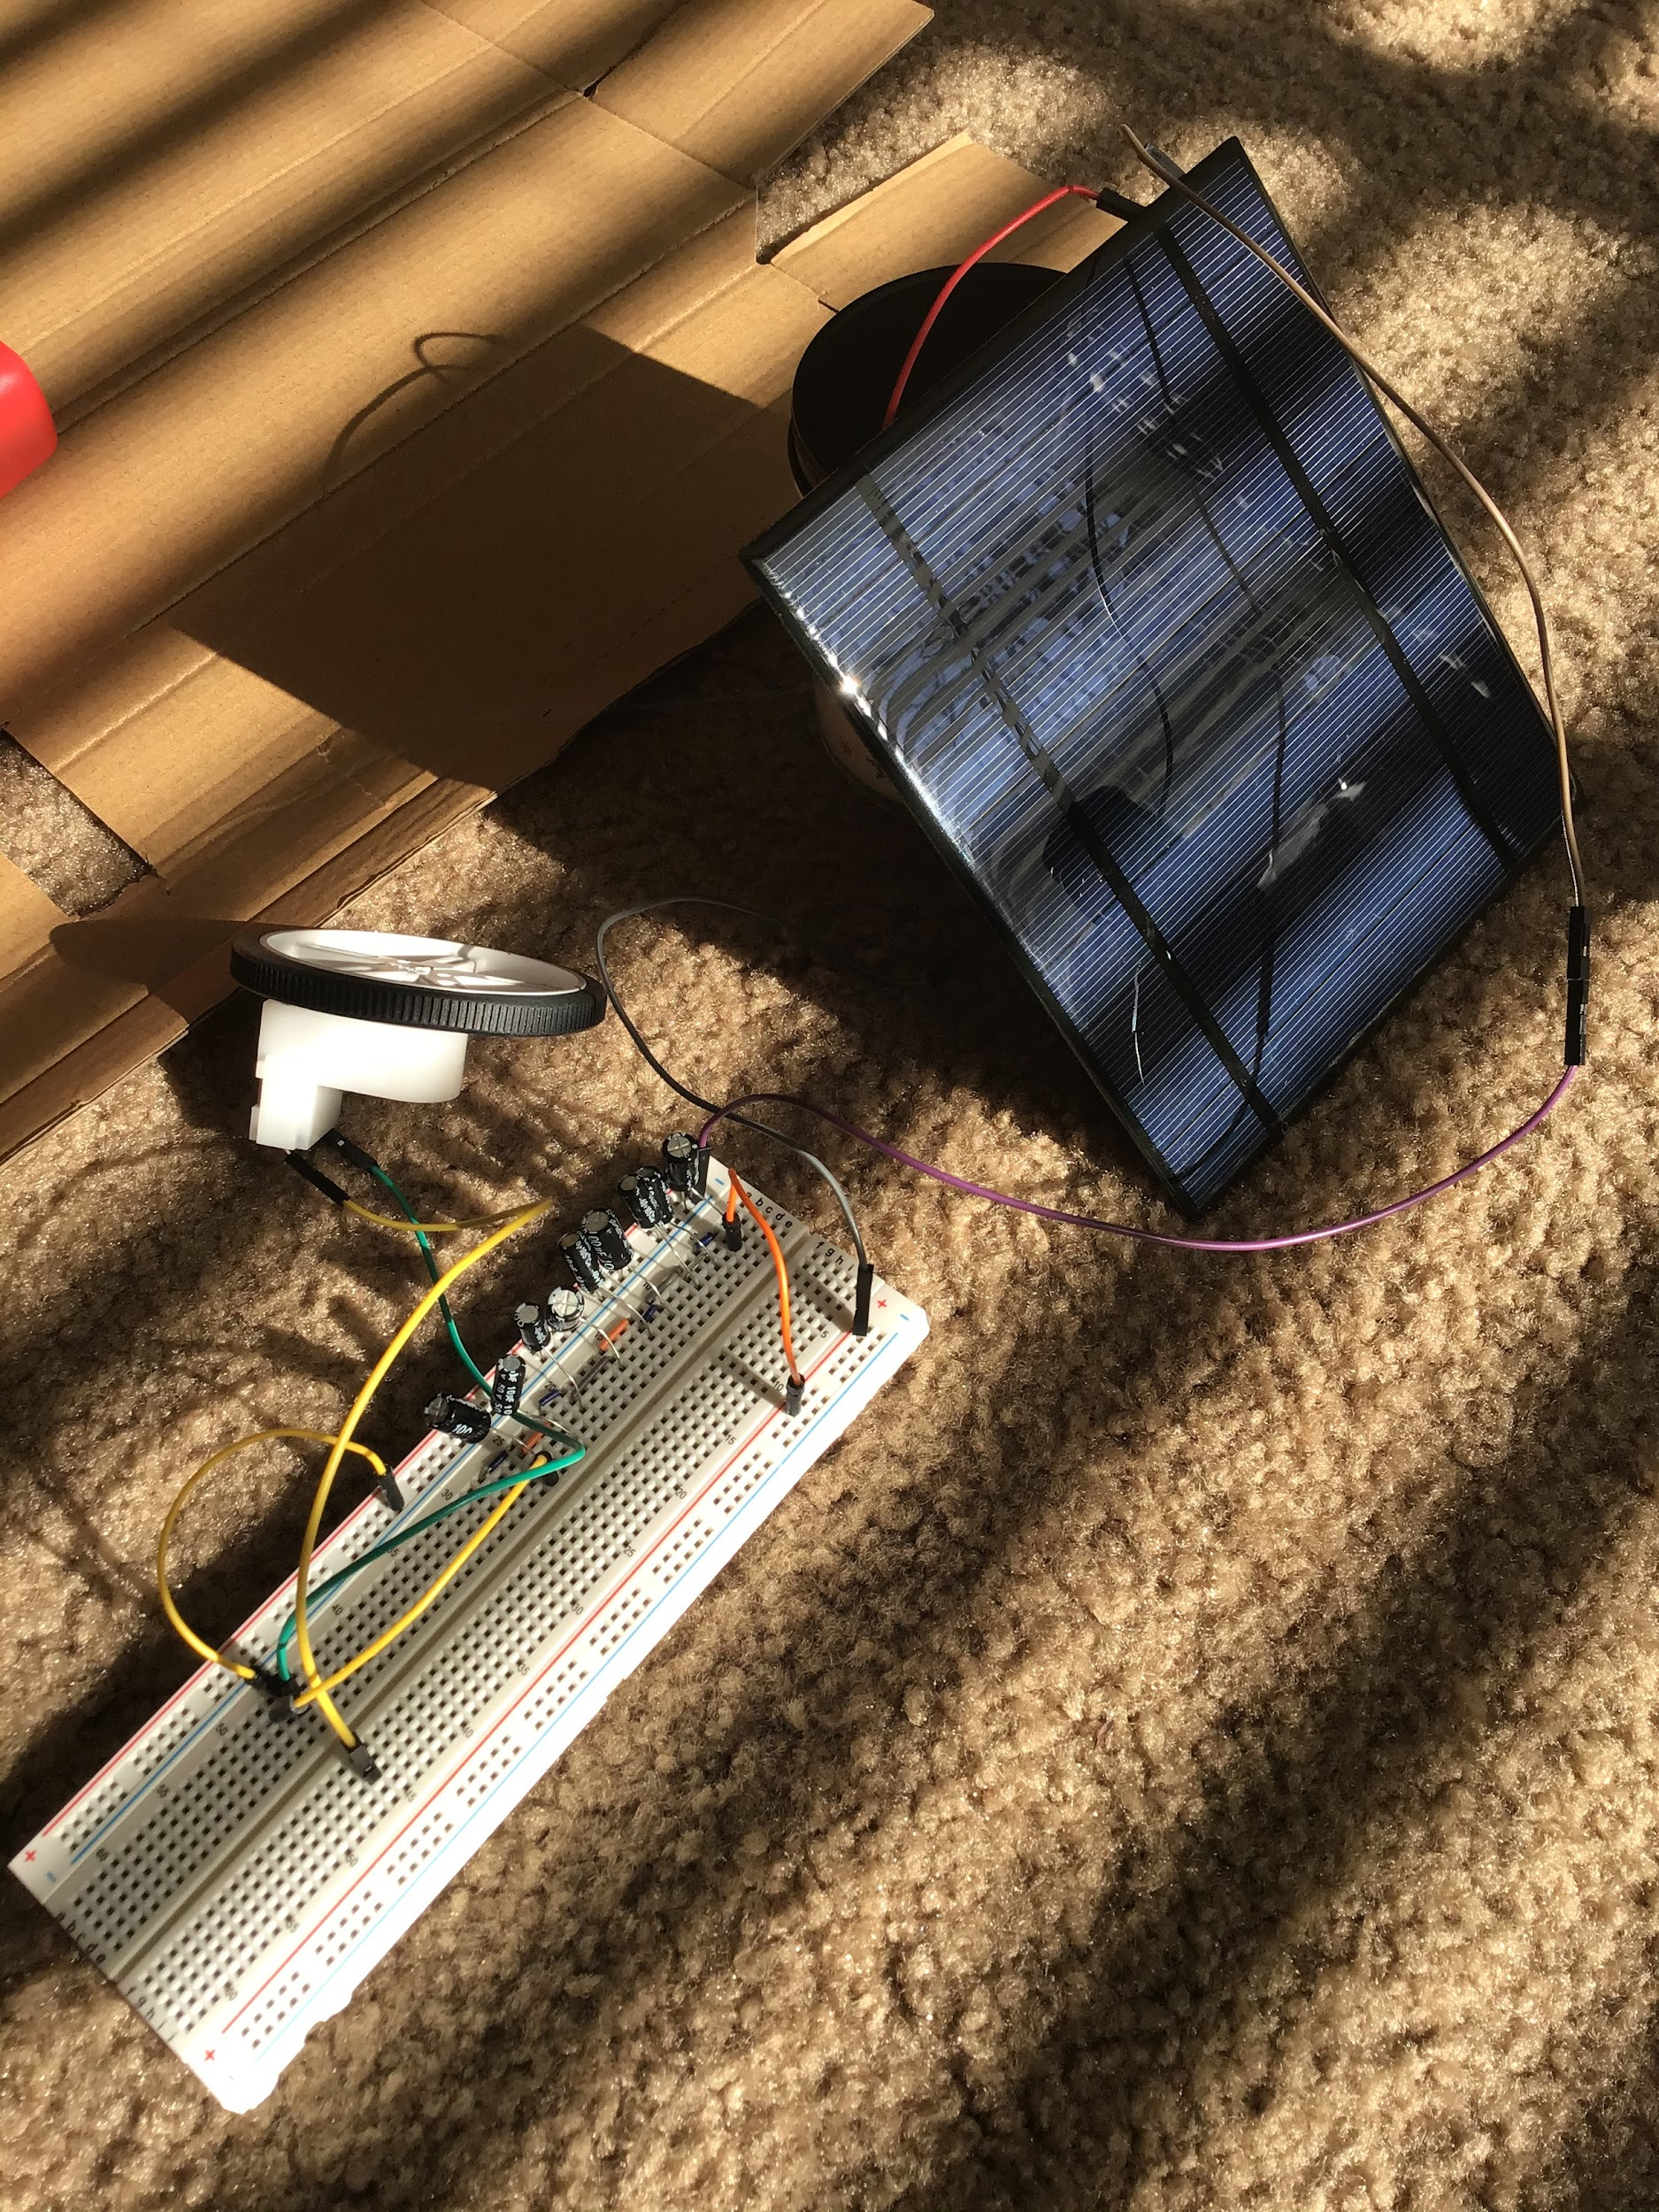
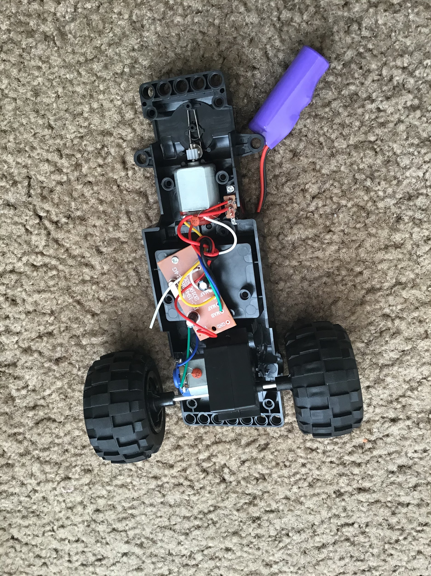
Anshu Paudyal

Slide 7
Ingmar Diaz
Hardware: Planned Altium Design Raun and I will attempt to finish Altium by this weekend
Mechanical Design: Completed most of flowchart with Anshu
Firmware: Started to do research OLED still need to meetup with Michael
Software: Helped test Aakansha’s Speedometer code.

Slide 8
Michael Foster
Hardware: Fuel Gauge for battery/capacitor life done.
Mechanical Design: Working on a casing to put LEDs in for prototyping feature.
Firmware/Software: Still need to work on the OLED with Ingmar.

Slide 9
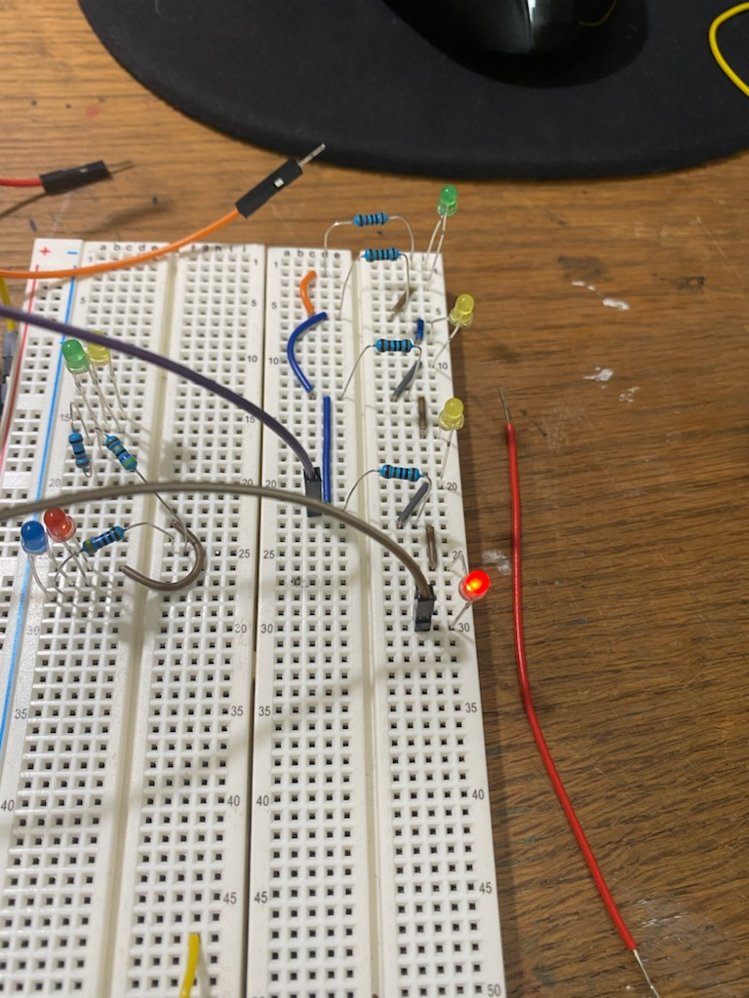
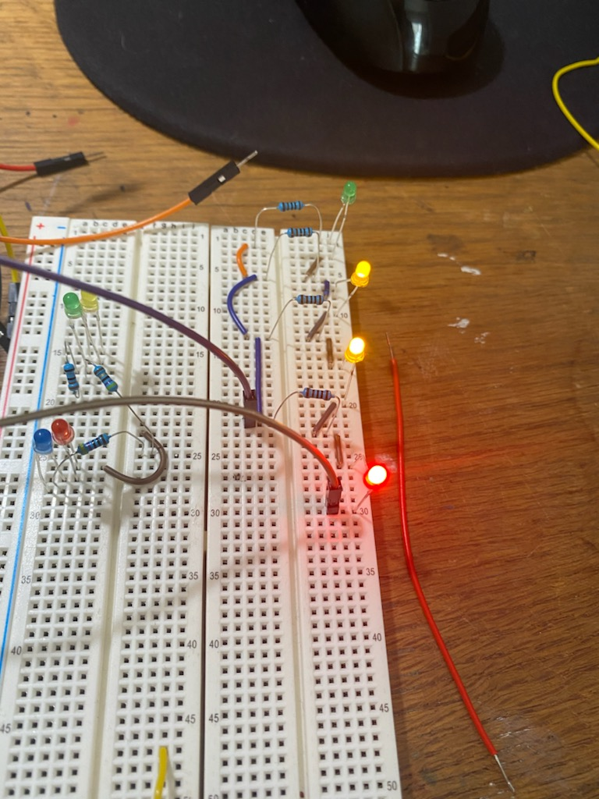
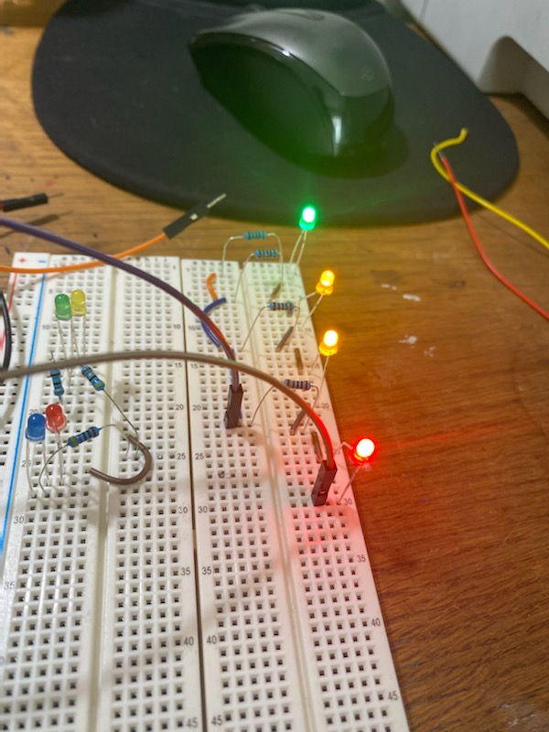
Michael Foster
We can also switch out this schematic by omitting one yellow LED and our voltage gauge will only go to about 4.5V.
Me and Ingmar still haven’t had a chance to meet up and work on the OLED together.
Red LED
0-1.7V
Yellow LEDs
1.7-3.8V
Green LED
4-6V

Slide 10
Raunaq Chopra
Hardware: Will be working on Altium designs with Ingmar over the coming weekend. The original plan for this week was to do some research on transistor switches and H-bridges, but due to an exam for another class, some of this work has been done by other teammates and I will be working further on this before the weekend.
Mechanical Design: I attended the meetings where the products to order were decided and discussed some factors to keep in mind while deciding which parts to order
Firmware and Software: The general consensus is to start working on the software once the hardware and mechanical parts are developed. We will be doing this via zoom meetings as a collective effort.

Slide 11
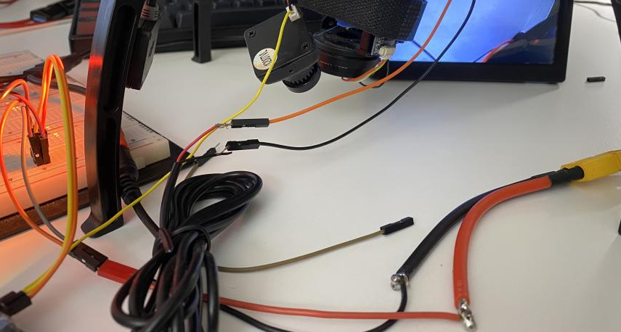
Yang Ye
Hardware: The video captured by the camera on the rover can be transmitted remotely to an receiver. The data stream will be then processed by the PC terminal. using openCV libraries)
Mechanical Design: setting up transmitter and receiver ’s physical connections
Firmware: setting up video signal data stream connection by study the datasheet of the chip.
Software: Preparing research OpenCV library in the next few weeks

Slide 12
Bill of Materials and Project Budget: Rover Truck and Solar Panels~~$87.42
Project Schedule and Risk Assessment: MILESTONES - Google Docs
Report and Presentation: No date yet.
Marketing and Video: No date yet.
Tips:
1. Be sure to identify tasks and contributions of each team member.
2. Use pictures as much as possible for effective communication.

